Slide 1

Descriptive Analytics in Story Telling in Tableau
MSBA 203 Final Project

Slide 2
Current Situation
Junior Achievement is a large international educational non-profit organization that is focused on student success and giving young people the knowledge and skills, they need to plan for the future and make smart academic, economic and career choices.
The 2008 Global Financial Crisis put extra strain on non-profits nationwide. This is because donors (typically companies and consumers) were on tighter budgets and had less funds available.
The organization still has to report on key non-profit activities.

Slide 3


Business Requirements and Solutions Overview
The purpose of this project is to provide the President of JA Philadelphia with a proof-of-concept dashboard solution that will allow real time access to summarized and detailed non-profit financial information. This information will provide greater insight into the financial health of JA and allow for more effective decision making to help JA deliver on its mission.
7 KPIs have been identified for use in the dashboard.

Slide 4
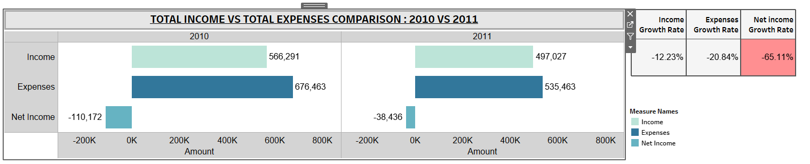
Key Insights and Recommendations KPI 1 – Income vs Expenses
Allows stakeholders to analyze trends and determine performance.
Observation: In this comparison, JA 2011's Income and Expense has decreased significantly resulting in increase in negative growth rate.
Recommendation: To reduce expenses and increase revenue, continue to conduct a thorough review of operations to generate more revenue to achieve improved performance.

Slide 5
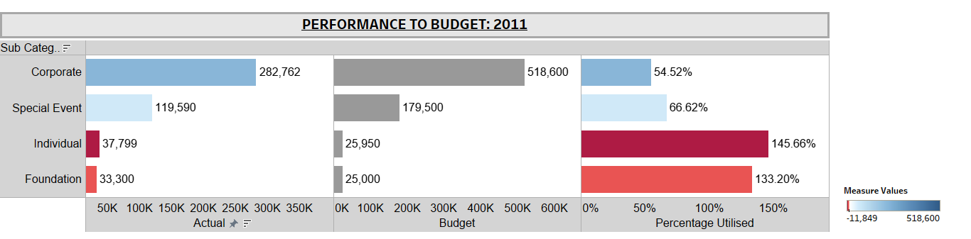
Key Insights and Recommendations
KPI 2 – Performance to Budget
This allows us to evaluate business performance against our plan, further analyze the cause of financial deviations, and support informed decisions by the management
Observation: The foundation and individual actual utilization is more than the allocated budget. This could be due to poor management of budgets.
Recommendation: By timely tracking actual performance against budget can help JA take proactive measures and keep expenses in control.
It is crucial that JA re-evaluates and their budgets.

Slide 6
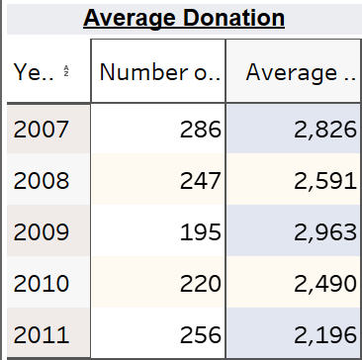
Key Insights and Recommendations
KPI 3 – No. Of Contributors and average donation per year
Observation: Number of Donors are rebounding after dropping to a low in the middle year. Average donations, though, are continuing to fall.
Recommendation: Increase fundraising, focusing on higher donations from each donor.

Slide 7
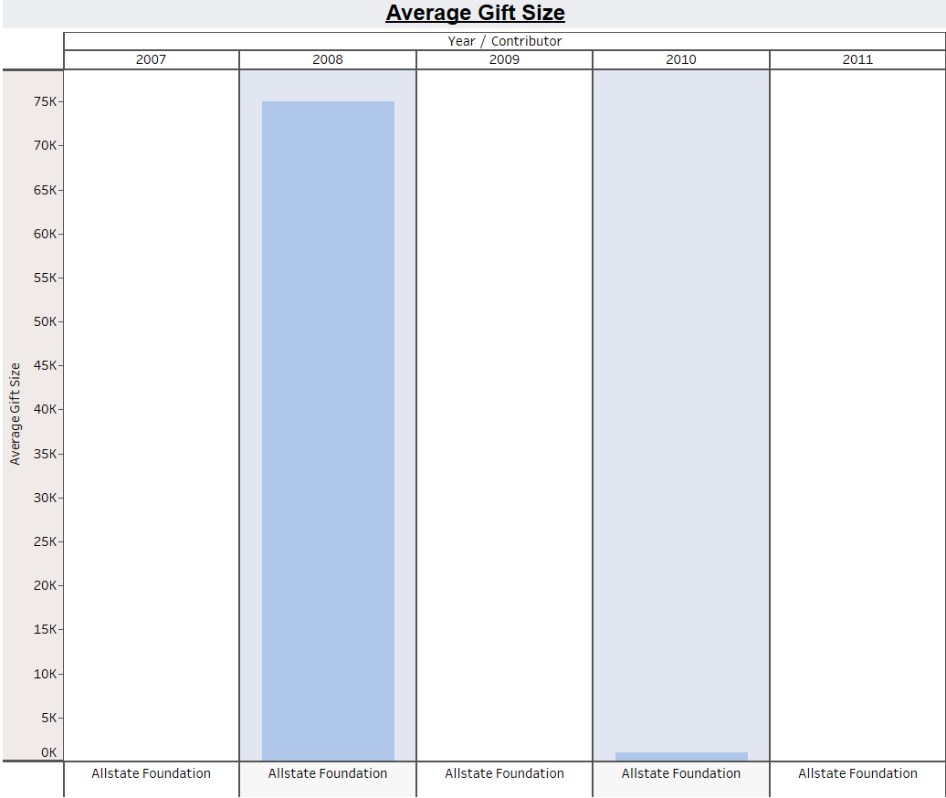
Key Insights and Recommendations
KPI 4 – Average size gift
Observation: Among the top 20 donors, the average gift sizes are around $15,000, with a few donors standing out Herr Foods Inc in 2007 and Allstate Foundation in 2008.
Recommendation: Similar to previously, focus fundraising on higher donations from each donor.

Slide 8
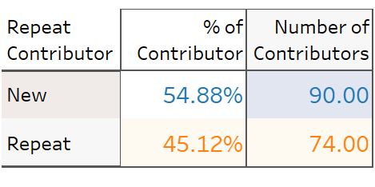
Key Insights and Recommendations
KPI 5 – Number, % Repeat contributors, Number of new contributors
Observation: A majority (55%) of contributors for 2011 were contributing for the first time.
Recommendation: Similar to previously, JA can focus fundraising on previous contributors, but they should not ignore continuing to find new contributors.

Slide 9
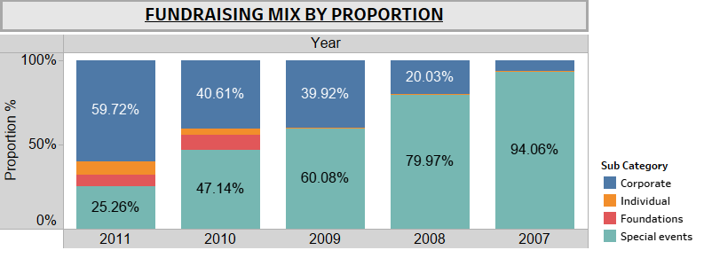
Key Insights and Recommendations
KPI 6 – Fundraising Mix
This allows us to identify the proportion of fundraised by each category. and further help manage budgets for next year
Observation: Corporate fundraising has increased, while special event fundraising is decreasing. Meanwhile, fundraising through foundations and individuals is improving and hence budgeting for foundational and individual needs to be improved as well.
Recommendation: Budget towards special event and corporate can be adjusted a bit to accommodate Foundation and Individual which is showing good potential recently.

Slide 10
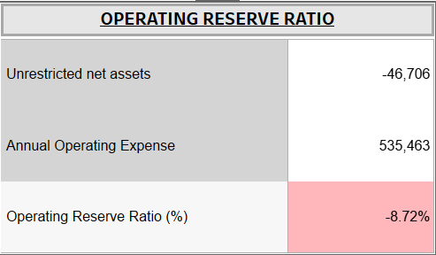
Key Insights and Recommendations
KPI 7– Operating Reserve Ratio
Very important metric used to manage risks and maintain financial stability
Observation: An operating reserve ratio of -9.03% implies that JA's unrestricted net assets are not sufficient to cover its annual operating expenses. In simple words its liabilities are more than assets.
Recommendation: JA should take immediate action to address all underlying issues for negative operating reserves through cost cutting, better manage budgets, increasing revenue generation efforts, or seeking additional funding sources.

Slide 11
Summary of Assumptions
For contributions, one assumption was that only positive values were used, negative and zero amounts were excluded.

